Slide 1
[220] Randomness
Meena Syamkumar
Mike Doescher

Slide 2
Announcements
P10
Due Friday May 1
Late Days may not be used
Everything must be turned in by May 1
Point Redistribution
Pinned Piazza Post
Grade distribution is on the syllabus page
Final Project
Assigned Monday April 27
Due Wednesday May 6 @11:59 PM
Grading / Resubmission / Deadline Extension – Google Form
Incredibly hard to change grades once they are submitted to the registrar
Course Evaluations
Contact Meena if you are interested in being a Mentor next fall.
Want more?
Data Science Consider CS 320!!!
Computer Science CS 200, 300, 400
Office Hours

Slide 3
Which series was randomly generated?
Which did I pick by hand?
1
2

Slide 4
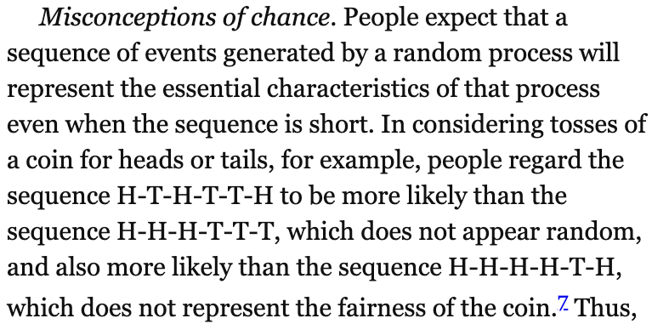
Recommended summer reading
Thinking, Fast and Slow
by Daniel Kahneman
The Signal and the Noise
by Nate Silver
The Visual Display of Quantitative Information
by Edward R. Tufte
Statistics Done Wrong
by Alex Reinhart

Slide 5
Recommended summer reading
Thinking, Fast and Slow
by Daniel Kahneman
The Signal and the Noise
by Nate Silver
The Visual Display of Quantitative Information
by Edward R. Tufte
Statistics Done Wrong
by Alex Reinhart

Slide 6
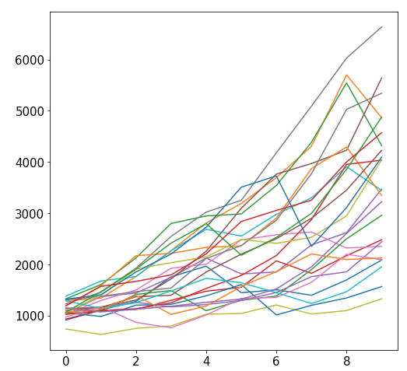
Why Randomize?
Games
Security
Simulation
our focus

Slide 7
Outline
choice()
bugs and seeding
significance
histograms
normal()

Slide 8
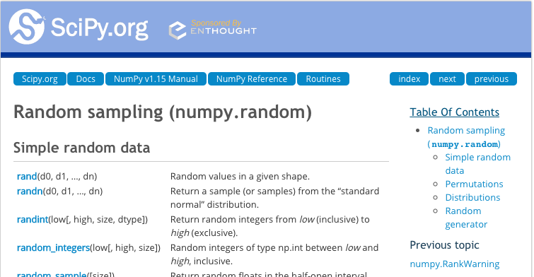
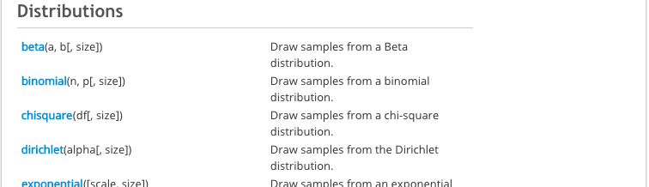
New Functions Today
numpy.random:
powerful collection of functions
Choice
Series.plot.hist:
similar to bar plot
visualize spread of random results
powerful collection of functions

Slide 9
choice
from numpy.random import choice
result = choice([<choice1, choice2, …])
list of things to
randomly choose from

Slide 10
choice
from numpy.random import choice
result = choice(["rock", "paper", "scissors"])
list of things to
randomly choose from
https://www.securifera.com/blog/2015/09/09/mmactf-2015-rock-paper-scissors-rps/

Slide 11
choice
from numpy.random import choice
result = choice(["rock", "paper", "scissors"])
print(result)
Output:
scissors
https://www.securifera.com/blog/2015/09/09/mmactf-2015-rock-paper-scissors-rps/

Slide 12
choice
from numpy.random import choice
result = choice(["rock", "paper", "scissors"])
print(result)
result = choice(["rock", "paper", "scissors"])
print(result)
Output:
scissors
rock
each time choice is
called, a value is randomly
selected (will vary run to run)

Slide 13
choice
from numpy.random import choice
choice(["rock", "paper", "scissors"], size=5)
for simulation, we'll often want
to compute many random results

Slide 14
choice
from numpy.random import choice
choice(["rock", "paper", "scissors"], size=5)
array(['rock', 'scissors', 'paper', 'rock', 'paper'], dtype='<U8')
it's list-like

Slide 15
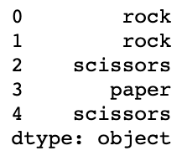
Random values and Pandas
from numpy.random import choice
# random Series
Series(choice(["rock", "paper", "scissors"], size=5))

Slide 16
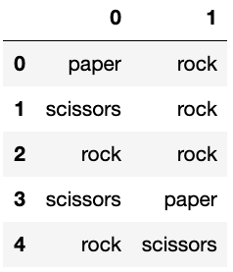
Random values and Pandas
from numpy.random import choice
# random Series
DataFrame(choice(["rock", "paper", "scissors"],
size=(5,2)))

Slide 17
Demo: exploring bias
choice(["rock", "paper", "scissors"])
Question 1: how can we make sure the randomization isn't biased?

Slide 18
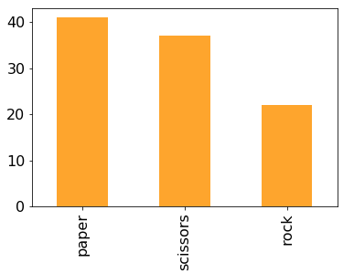
Demo: exploring bias
choice(["rock", "paper", "scissors"])
Question 1: how can we make sure the randomization isn't biased?

Slide 19
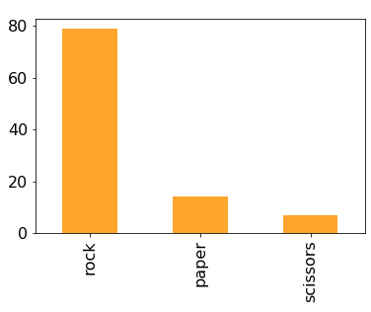
Demo: exploring bias
choice(["rock", "paper", "scissors"])
Question 1: how can we make sure the randomization isn't biased?
Question 2: how can we make it biased (if we want it to be)?
p=[...]

Slide 20
Random Strings vs. Random Ints
from numpy.random import choice, normal
# random string: rock, paper, or scissors
choice(["rock", "paper", "scissors"])
# random int: 0, 1, or 2
choice([0, 1, 2])

Slide 21
Random Strings vs. Random Ints
from numpy.random import choice, normal
# random string: rock, paper, or scissors
choice(["rock", "paper", "scissors"])
# random int: 0, 1, or 2
choice([0, 1, 2])
# random int (approach 2): 0, 1, or 2
choice(3)
same
random non-negative int
that is less than 3

Slide 22
Outline
choice()
bugs and seeding
significance
histograms
normal()

Slide 23
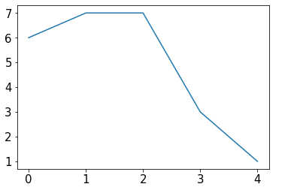
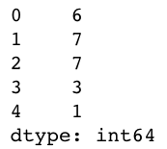
Example: change over time
s = Series(choice(10, size=5))
s.plot.line()

Slide 24
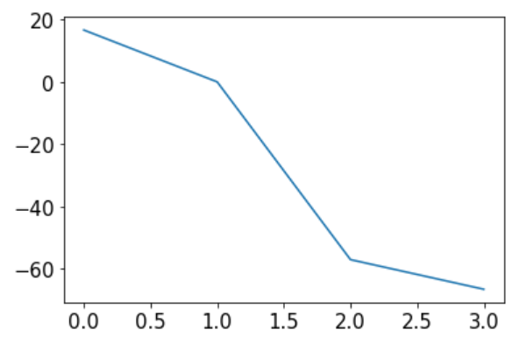
Example: change over time
s = Series(choice(10, size=5))
s.plot.line()
percents = []
for i in range(1, len(s)):
diff = 100 * (s[i] / s[i-1] - 1)
percents.append(diff)
Series(percents).plot.line()
what are we computing for diff?

Slide 25
Example: change over time
s = Series(choice(10, size=5))
s.plot.line()
percents = []
for i in range(1, len(s)):
diff = 100 * (s[i] / s[i-1] - 1)
percents.append(diff)
Series(percents).plot.line()
can you identify the bug in the code?

Slide 26
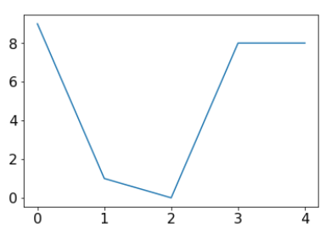
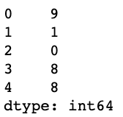
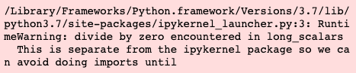
Example: change over time
s = Series(choice(10, size=5))
s.plot.line()
percents = []
for i in range(1, len(s)):
diff = 100 * (s[i] / s[i-1] - 1)
percents.append(diff)
Series(percents).plot.line()
can you identify the bug in the code?

Slide 27
Not all bugs are equal!
scary bugs
"nice" bugs
non-deterministic
deterministic (reproducible)
https://owlcation.com/stem/5-Badass-Bugs-That-You-Should-Have-Nightmares-About

Slide 28
Not all bugs are equal!
scary bugs
"nice" bugs
non-deterministic
deterministic (reproducible)
system related
randomness
https://owlcation.com/stem/5-Badass-Bugs-That-You-Should-Have-Nightmares-About

Slide 29
Not all bugs are equal!
scary bugs
"nice" bugs
non-deterministic
deterministic (reproducible)
system related
randomness
large data
small data
semantic
syntax
runtime
https://owlcation.com/stem/5-Badass-Bugs-That-You-Should-Have-Nightmares-About

Slide 30
Not all bugs are equal!
scary bugs
"nice" bugs
non-deterministic
deterministic (reproducible)
system related
randomness
large data
small data
semantic
????
syntax
runtime
https://owlcation.com/stem/5-Badass-Bugs-That-You-Should-Have-Nightmares-About

Slide 31
Not all bugs are equal!
scary bugs
"nice" bugs
non-deterministic
deterministic (reproducible)
system related
randomness
seeding
large data
small data
semantic
assert
syntax
runtime
https://owlcation.com/stem/5-Badass-Bugs-That-You-Should-Have-Nightmares-About

Slide 32
Pseudorandom Generators
"Random" generators are really just pseudorandom
684 559 629 192 835 ...
37 235 908 72 767 ...
168 527 493 584 534 ...
874 664 249 643 952 ...

Slide 33
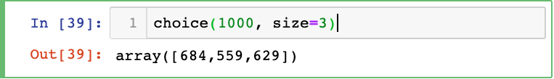
Pseudorandom Generators
"Random" generators are really just pseudorandom
684 559 629 192 835 ...
37 235 908 72 767 ...
168 527 493 584 534 ...
874 664 249 643 952 ...

Slide 34
Pseudorandom Generators
"Random" generators are really just pseudorandom
684 559 629 192 835 ...
37 235 908 72 767 ...
168 527 493 584 534 ...
874 664 249 643 952 ...

Slide 35
Pseudorandom Generators
"Random" generators are really just pseudorandom
seeds
684 559 629 192 835 ...
37 235 908 72 767 ...
168 527 493 584 534 ...
874 664 249 643 952 ...
100:
101:
102:
...:

Slide 36
Seeding
What if I told you that you can choose your track?
seeds
100:
684 559 629 192 835 ...
37 235 908 72 767 ...
168 527 493 584 534 ...
874 664 249 643 952 ...
101:
102:
...:

Slide 37
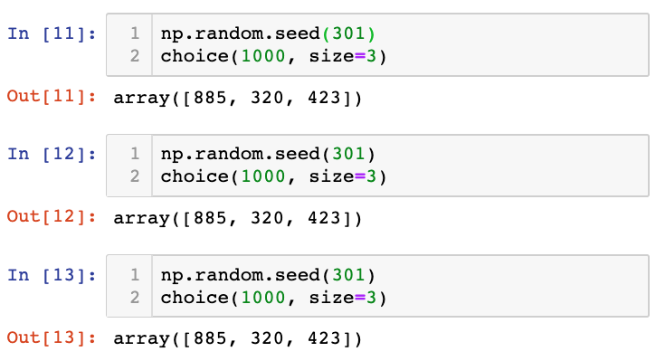
Seeding
What if I told you that you can choose your track?

Slide 38
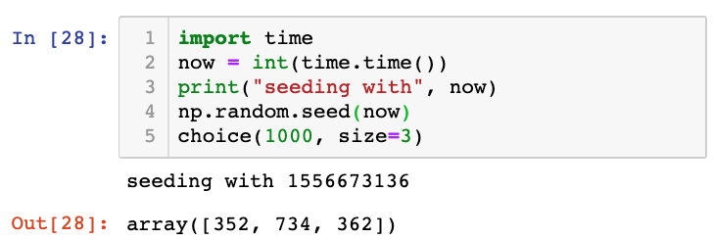
Seeding
Common approach for simulations:
seed using current time
print seed
use the seed for reproducing bugs, as necessary

Slide 39
Outline
choice()
bugs and seeding
significance
histograms
normal()

Slide 40
In a noisy world, what is noteworthy?
https://dilbert.com/strip/2001-10-25

Slide 41
Is this coin biased?
Call shenanigans?
51
49
a statistician might say we're trying to decide if the evidence that the coin isn't fair is statistically significant
whoever has the coin cheated
(it's not 50/50 heads/tails)

Slide 42
Is this coin biased?
Call shenanigans? No.
51
49

Slide 43
Is this coin biased?
Call shenanigans? No.
51
49
Call shenanigans?
5
95

Slide 44
Is this coin biased?
Call shenanigans? No.
51
49
Call shenanigans? Yes.
5
95
Note: there is a non-zero probability that a fair coin will do this, but the odds are slim

Slide 45
Is this coin biased?
Call shenanigans? No.
51
49
Call shenanigans? Yes.
5
95
Call shenanigans?
55
45
Call shenanigans?
55 million
45 million

Slide 46
Is this coin biased?
Call shenanigans? No.
51
49
Call shenanigans? Yes.
5
95
Call shenanigans? No.
55
45
Call shenanigans? Yes.
55 million
45 million

Slide 47
Is this coin biased?
Call shenanigans? No.
51
49
Call shenanigans? Yes.
5
95
large skew is good evidence of shenanigans
Call shenanigans? No.
55
45
Call shenanigans? Yes.
55 million
45 million
small skew over large samples is good evidence

Slide 48
Demo: CoinSim
Call shenanigans?
60
40
Strategy: simulate a fair coin
"flip" it 100 times using numpy.random.choice
count heads
repeat above 10K times
[50, 61, 51, 44, 39, 43, 51, 49, 49, 38, ...]

Slide 49
Demo: CoinSim
Call shenanigans?
60
40
we got 10 more heads than we expect on average
how common is this?
Strategy: simulate a fair coin
"flip" it 100 times using numpy.random.choice
count heads
repeat above 10K times
[50, 61, 51, 44, 39, 43, 51, 49, 49, 38, ...]

Slide 50
Demo: CoinSim
Call shenanigans?
60
40
we got 10 more heads than we expect on average
how common is this?
Strategy: simulate a fair coin
"flip" it 100 times using numpy.random.choice
count heads
repeat above 10K times
[50, 61, 51, 44, 39, 43, 51, 49, 49, 38, ...]
11 more
12 less

Slide 51
Outline
choice()
bugs and seeding
significance
histograms
normal()

Slide 52
Frequencies across categories
bars are a good way to view frequencies across categories
s = Series(["rock", "rock", "paper", "scissors", "scissors", "scissors"])
s.value_counts().plot.bar(color="orange")

Slide 53
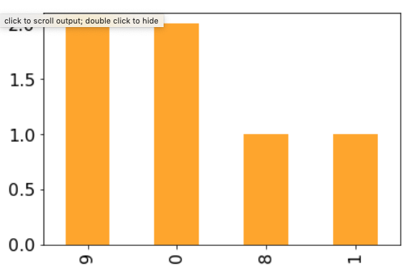
Frequencies across numbers
bars are a bad way to view frequencies across numbers
s = Series([0, 0, 1, 8, 9, 9])
s.value_counts().plot.bar(color="orange")
numbers not ordered

Slide 54
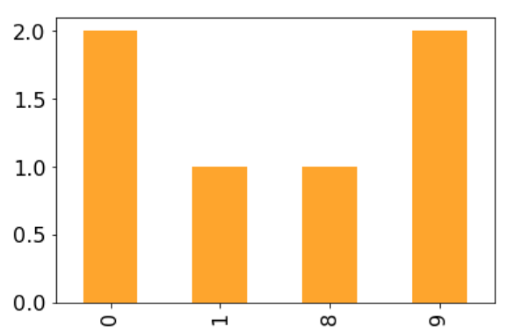
Frequencies across numbers
bars are a bad way to view frequencies across numbers
s = Series([0, 0, 1, 8, 9, 9])
s.value_counts().sort_index().plot.bar(color="orange")
gap between 1 and 8 not obvious

Slide 55
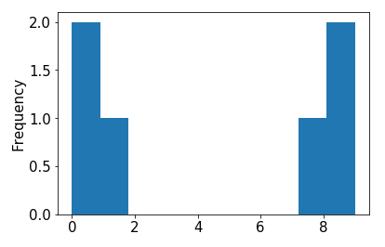
Frequencies across numbers
bars are a bad way to view frequencies across numbers
s = Series([0, 0, 1, 8, 9, 9])
s.value_counts().sort_index().plot.bar() s.plot.hist()

Slide 56
Frequencies across numbers
histograms are a good way to view frequencies across numbers
s = Series([0, 0, 1, 8, 9, 9])
s.value_counts().sort_index().plot.bar() s.plot.hist()
this kind of plot is called a histogram

Slide 57
Frequencies across numbers
histograms are a good way to view frequencies across numbers
s = Series([0.1, 0, 1, 8, 9, 9.2])
s.value_counts().sort_index().plot.bar() s.plot.hist()
both 0 and 0.1
a histogram "bins" nearby numbers to create discrete bars

Slide 58
Frequencies across numbers
histograms are a good way to view frequencies across numbers
s = Series([0.1, 0, 1, 8, 9, 9.2])
s.value_counts().sort_index().plot.bar() s.plot.hist(bins=10)
we can control the number of bins

Slide 59
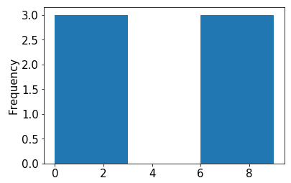
Frequencies across numbers
histograms are a good way to view frequencies across numbers
s = Series([0.1, 0, 1, 8, 9, 9.2])
s.value_counts().sort_index().plot.bar() s.plot.hist(bins=3)
too few bins provides too little detail

Slide 60
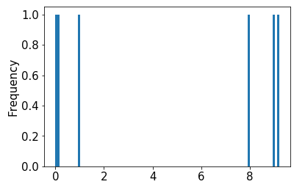
Frequencies across numbers
histograms are a good way to view frequencies across numbers
s = Series([0.1, 0, 1, 8, 9, 9.2])
s.value_counts().sort_index().plot.bar() s.plot.hist(bins=100)
too many bins provides too much detail (equally bad)

Slide 61
Frequencies across numbers
histograms are a good way to view frequencies across numbers
s = Series([0.1, 0, 1, 8, 9, 9.2])
s.value_counts().sort_index().plot.bar() s.plot.hist(bins=10)
pandas chooses the default bin boundaries

Slide 62
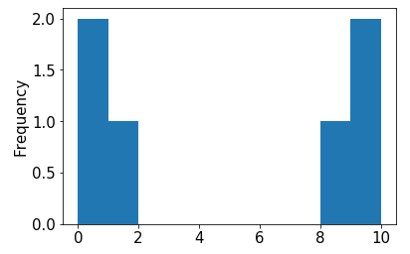
Frequencies across numbers
histograms are a good way to view frequencies across numbers
s = Series([0.1, 0, 1, 8, 9, 9.2])
s.value_counts().sort_index().plot.bar() s.plot.hist(bins=[0,1,2,3,4,5,6,7,8,9,10])
we can override the defaults

Slide 63
Frequencies across numbers
histograms are a good way to view frequencies across numbers
s = Series([0.1, 0, 1, 8, 9, 9.2])
s.value_counts().sort_index().plot.bar() s.plot.hist(bins=range(11))
this is easily done with range

Slide 64
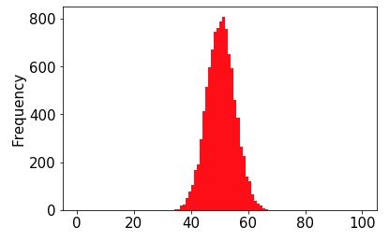
Demo: Visualize CoinSim Results
number of heads (out of 100)

Slide 65
Demo: Visualize CoinSim Results
number of heads (out of 100)
this shape resembles what we often call a normal distribution or a "bell curve"

Slide 66
Demo: Visualize CoinSim Results
number of heads (out of 100)
this shape resembles what we often call a normal distribution or a "bell curve"
in general, if we take large samples enough times, the sample averages will look like this (we won't discuss exceptions here)

Slide 67
Demo: Visualize CoinSim Results
number of heads (out of 100)
numpy can directly
generate random
numbers fitting a
normal distribution
this shape resembles what we often call a normal distribution or a "bell curve"
in general, if we take large samples enough times, the sample averages will look like this (we won't discuss exceptions here)

Slide 68
Outline
choice()
bugs and seeding
significance
histograms
normal()

Slide 69
normal
from numpy.random import choice, normal
import numpy as np
for i in range(10):
print(normal())

Slide 70
normal
from numpy.random import choice, normal
import numpy as np
for i in range(10):
print(normal())
Output:
-0.18638553993371157
0.02888452916769247
1.2474561113726423
-0.5388224399358179
-0.45143322136388525
-1.4001861112018241
0.28119371511868047
0.2608861898556597
-0.19246288728955144
0.2979572961710292
average is 0 (over many calls)
numbers closer to 0 more likely
-x just as likely as x

Slide 71
normal
from numpy.random import choice, normal
import numpy as np
s = Series(normal(size=10000))

Slide 72
normal
from numpy.random import choice, normal
import numpy as np
s = Series(normal(size=10000))
s.plot.hist()

Slide 73
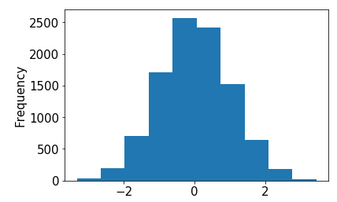
normal
from numpy.random import choice, normal
import numpy as np
s = Series(normal(size=10000))
s.plot.hist()

Slide 74
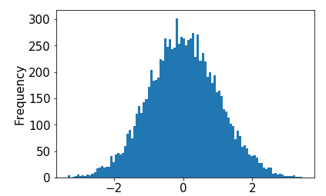
normal
from numpy.random import choice, normal
import numpy as np
s = Series(normal(size=10000))
s.plot.hist(bins=100)

Slide 75
normal
from numpy.random import choice, normal
import numpy as np
s = Series(normal(size=10000))
s.plot.hist(bins=100, loc= , scale= )

Slide 76
normal
from numpy.random import choice, normal
import numpy as np
s = Series(normal(size=10000))
s.plot.hist(bins=100, loc= , scale= )
try plugging in different values
(defaults are 0 and 1, respectively)

Slide 77
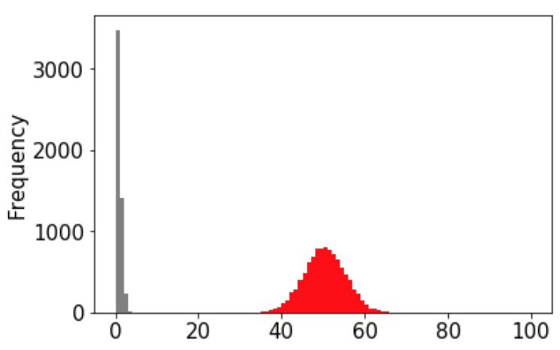
Demo: plot overlay
10K samples of 100 coin flips
10K samples from normal(size=10000)

Slide 78
Demo: plot overlay
version 1
10K samples of 100 coin flips
10K samples from normal(size=10000)
goal: play with loc and scale arguments to normal until gray overlaps red

Slide 79
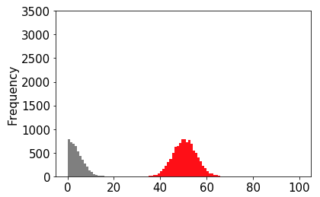
Demo: plot overlay
version 2
10K samples of 100 coin flips
10K samples from normal(size=10000)
goal: play with loc and scale arguments to normal until gray overlaps red

Slide 80
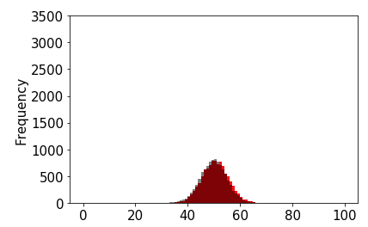
Demo: plot overlay
version 3
10K samples of 100 coin flips
10K samples from normal(size=10000)
goal: play with loc and scale arguments to normal until gray overlaps red

Slide 81


Slide 82
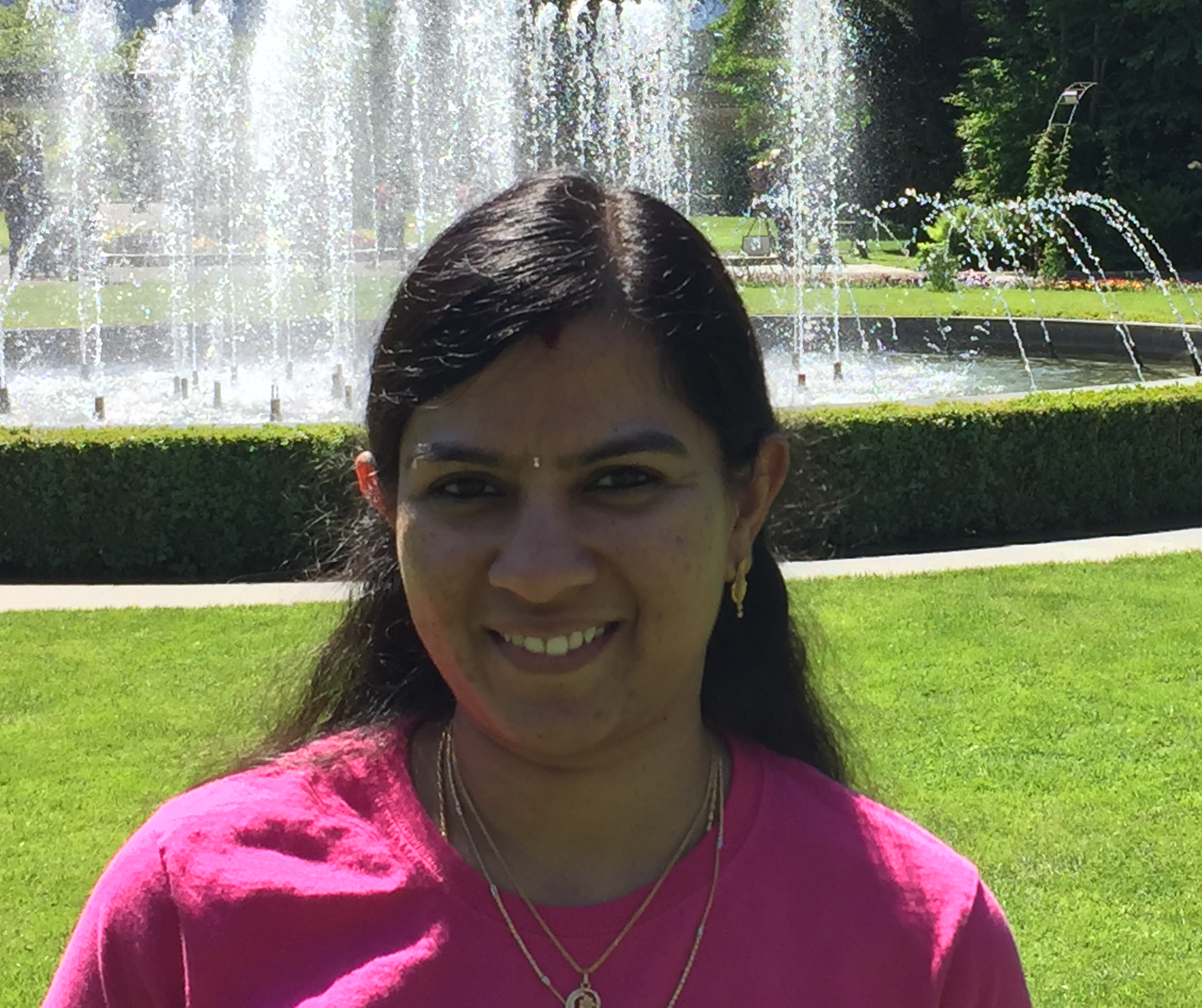

Slide 83
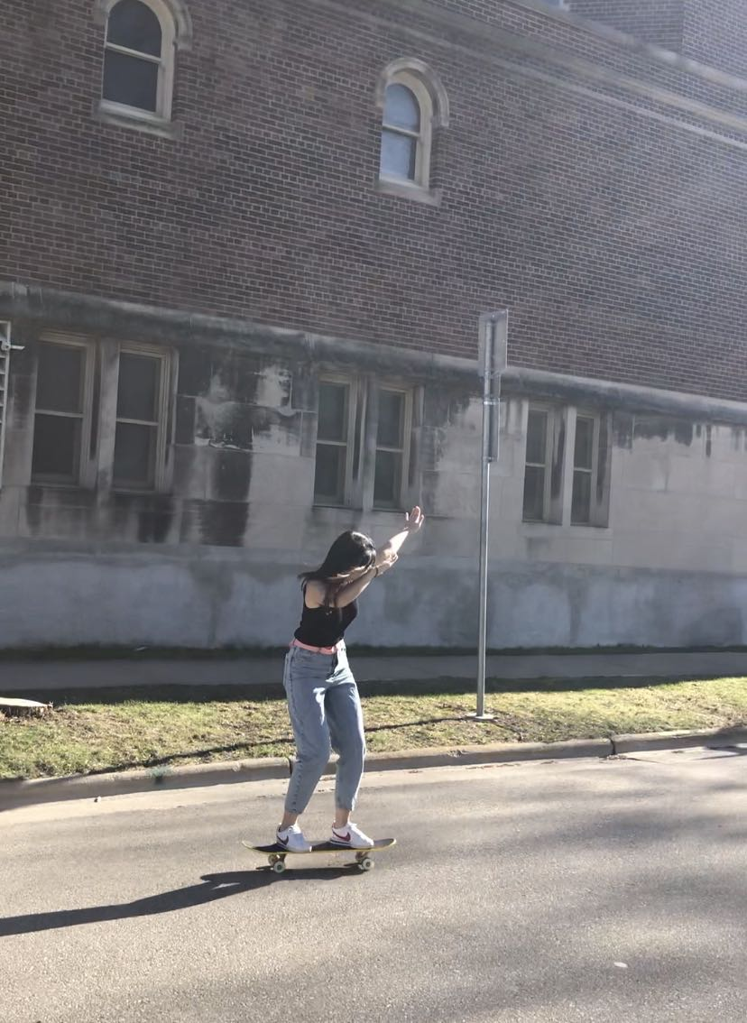
Yuchen Zeng: “Thank you so much for
your hard work”

Slide 84

Sean Chung: “Thank you and stay safe”

Slide 85

Bhavya Goyal: “Data doesn’t lie. Data Scientists do!”

Slide 86

Zhenmei Shi: “Good luck this semester, and
in your studies at UW-Madison!”

Slide 87

Sourav Pal: “Good luck with data
crunching! Go grab them all!”

Slide 88

Tyler Caraza-Harter: ”You should all take CS 320 next fall!”

